Slide 1

Finding the Minimum-Weight $k$-path
Avinatan Hassidim, Orgad Keller, Moshe Lewenstein, Liam Roditty
Bar-Ilan University
To appear in WADS`13

Slide 2


Problem
Given an edge-weighted graph $H=(V,E,w)$, parameter $k$ and a value $M$ where $w:E→\{−M,…,M\}$, our goal is to find the minimum-weight simple-path visiting $k$ vertices
2
1
2
$$k=4$$
2
2
3
4
3

Slide 3
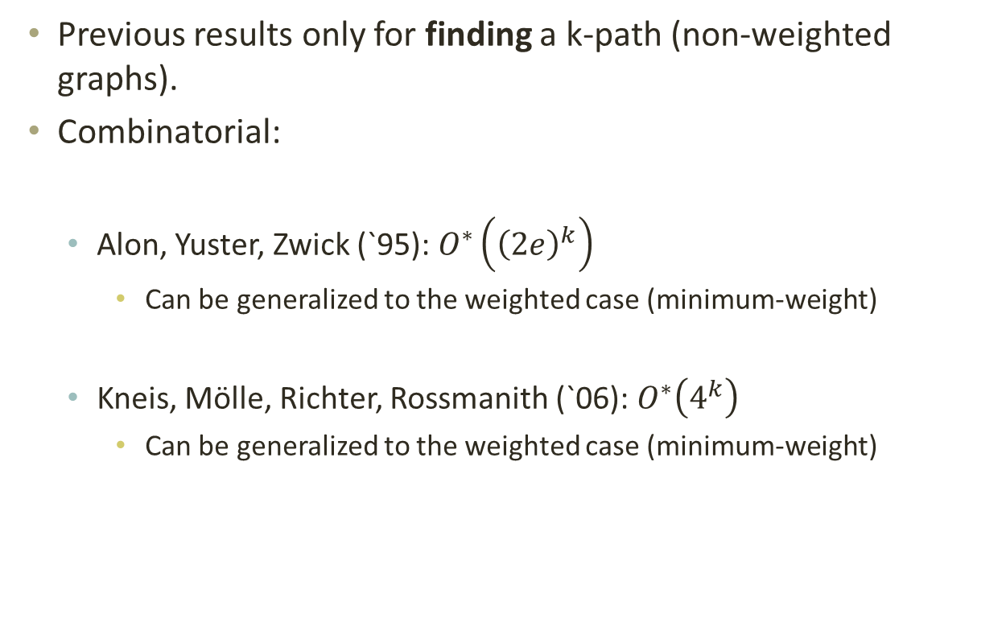
Previous Work
Previous results only for finding a k-path (non-weighted graphs).
Combinatorial:
  Alon, Yuster, Zwick (`95): $O^{∗}\left({\left(2e\right)}^{k}\right)$
    Can be generalized to the weighted case (minimum-weight)
  Kneis, Mölle, Richter, Rossmanith (`06): $O^{∗}\left(4^{k}\right)$
    Can be generalized to the weighted case (minimum-weight)

Slide 4
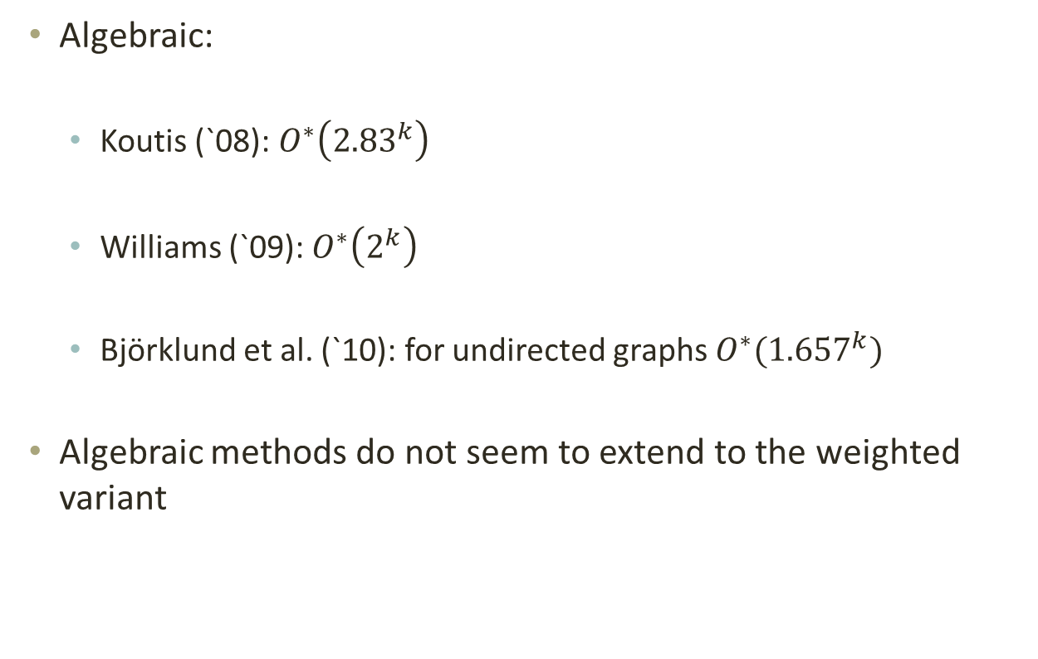
Previous Work
Algebraic:
  Koutis (`08): $O^{∗}\left({2.83}^{k}\right)$
  Williams (`09): $O^{∗}\left(2^{k}\right)$
  Björklund et al. (`10): for undirected graphs $O^{∗}({1.657}^{k})$
Algebraic methods do not seem to extend to the weighted variant

Slide 5
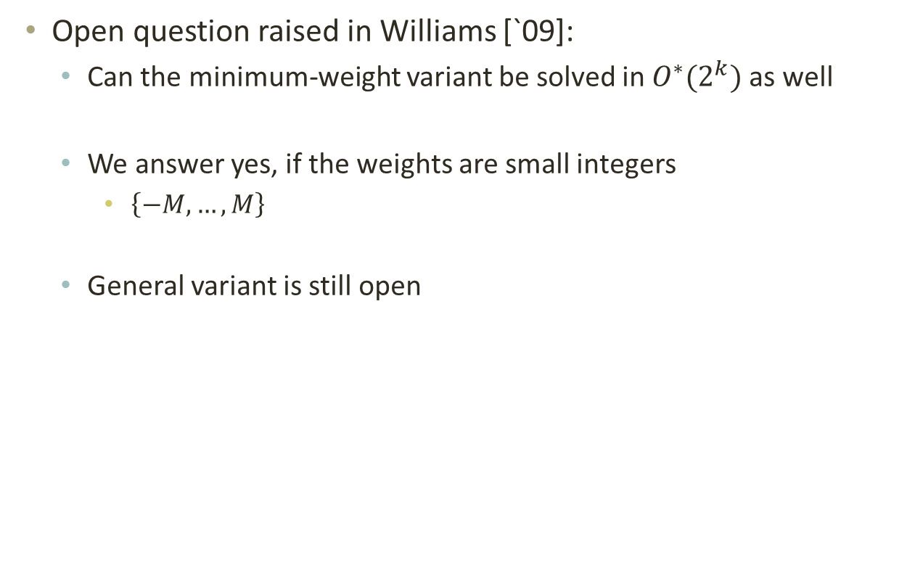
Open Question
Open question raised in Williams [`09]:
  Can the minimum-weight variant be solved in $O^{∗}(2^{k})$ as well
  We answer yes, if the weights are small integers
    $\left\{−M,…,M\right\}$
  General variant is still open

Slide 6
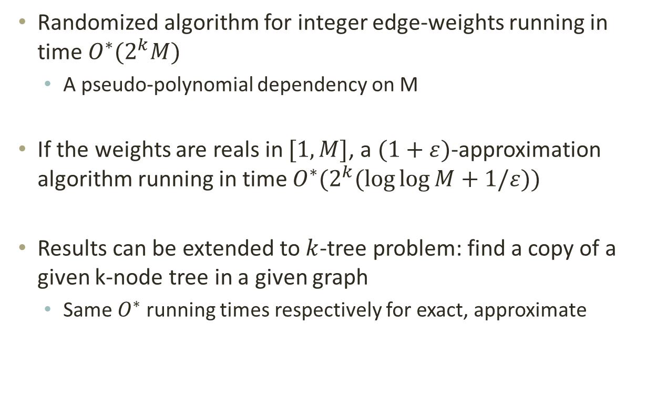
Our Results
Randomized algorithm for integer edge-weights running in time $O^{∗}(2^{k}M)$
  A pseudo-polynomial dependency on M
If the weights are reals in $[1,M]$, a $(1+ε)$-approximation algorithm running in time $O^{∗}(2^{k}(\log{\log{M}}+1/ε))$
Results can be extended to $k$-tree problem: find a copy of a given k-node tree in a given graph
  Same $O^{∗}$ running times respectively for exact, approximate

Slide 7

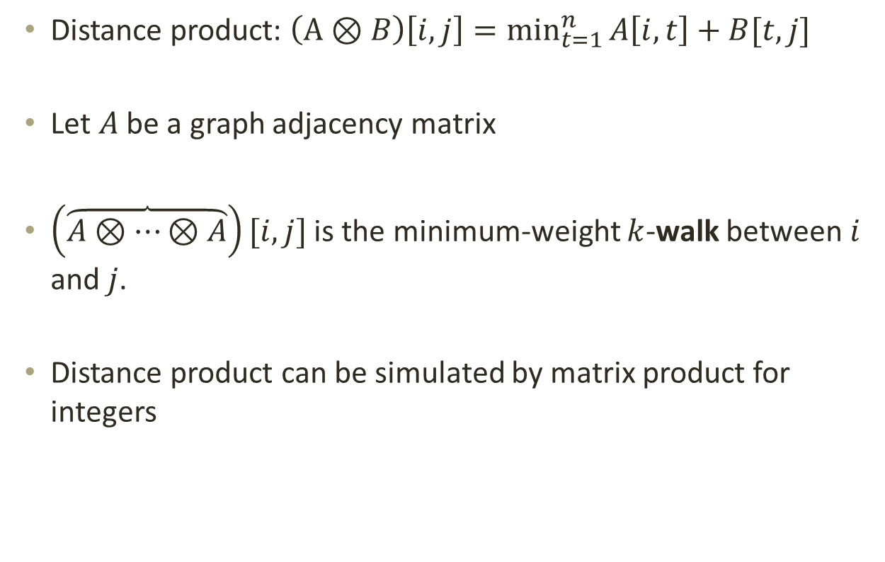



Distance Matrix-Product
Distance product: $\left(A⊗B\right)\left[i,j\right]=\min_{t=1}^{n}{A\left[i,t\right]+B[t,j]}$
Let $A$ be a graph adjacency matrix
$\left(\overbrace{A⊗…⊗A}\right)[i,j]$ is the minimum-weight $k$-walk between $i$ and $j$.
Distance product can be simulated by matrix product for integers
$$k−1$$
$$t$$
3
2
$$i$$
3
$$j$$
5
2

Slide 8



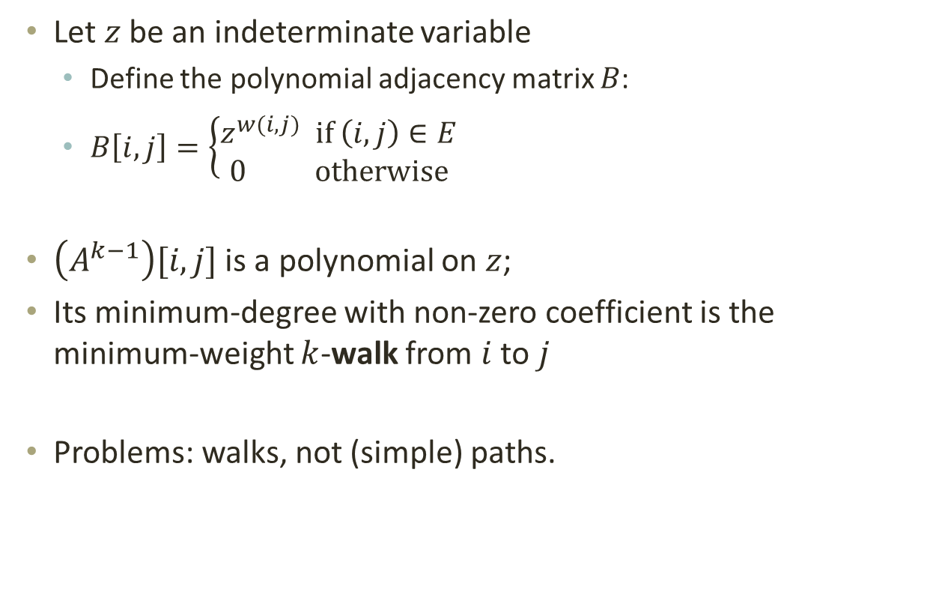






Simulation
Let $z$ be an indeterminate variable
  Define the polynomial adjacency matrix $B$:
  $B\left[i,j\right]=\left\{\begin{aligned}z^{w(i,j)} \text{if} \left(i,j\right)∈E \\ 0 \text{otherwise}\end{aligned}\right.$
$\left(A^{k−1}\right)[i,j]$ is a polynomial on $z$;
Its minimum-degree with non-zero coefficient is the minimum-weight $k$-walk from $i$ to $j$
Problems: walks, not (simple) paths.
$$k$$
$$z^{3}$$
$$z^{2}$$
$$i$$
$$z^{3}$$
$$j$$
$$z^{5}$$
$$z^{2}$$
$$A^{2}\left[i,j\right]=z^{5}+z^{7}$$

Slide 9
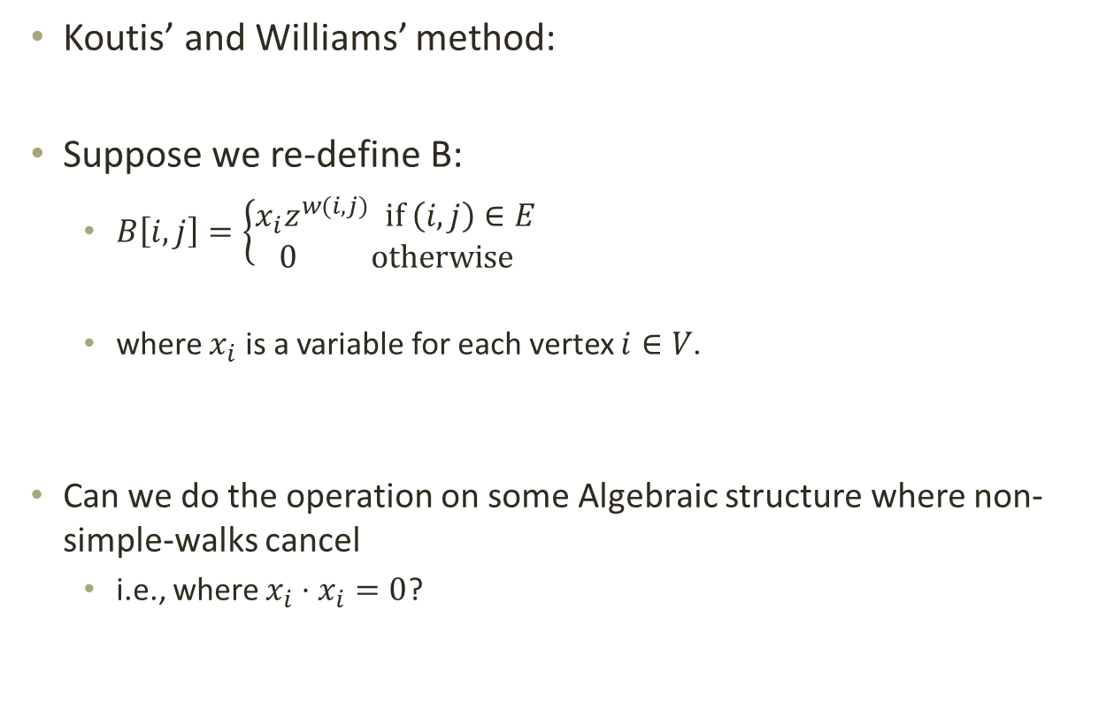

Intuition – Eliminate $k$-walks
Koutis’ and Williams’ method:
Suppose we re-define B:
    $B\left[i,j\right]=\left\{\begin{aligned}{x_{i}z}^{w(i,j)} \text{if} \left(i,j\right)∈E \\ 0 \text{otherwise}\end{aligned}\right.$
    where $x_{i}$ is a variable for each vertex $i∈V$.
  Can we do the operation on some Algebraic structure where non-simple-walks cancel
    i.e., where $x_{i}⋅x_{i}=0$?

Slide 10
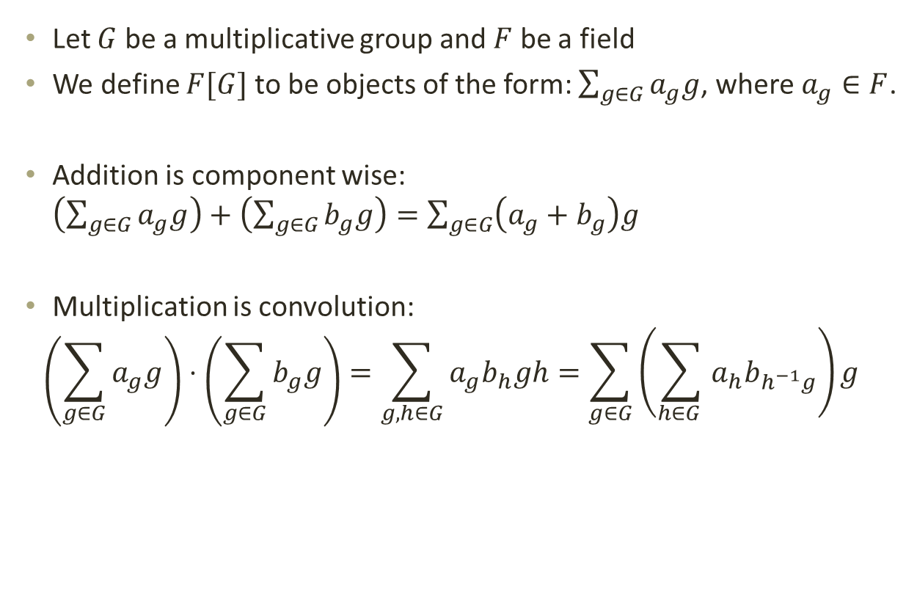
Algebra
Let $G$ be a multiplicative group and $F$ be a field
We define $F[G]$ to be objects of the form: $\sum_{g∈G}{a_{g}g}$, where $a_{g}∈F$.
Addition is component wise: $\left(\sum_{g∈G}{a_{g}g}\right)+\left(\sum_{g∈G}{b_{g}g}\right)=\sum_{g∈G}{\left(a_{g}+b_{g}\right)g}$
Multiplication is convolution:
$$\left(\sum_{g∈G}{a_{g}g}\right)⋅\left(\sum_{g∈G}{b_{g}g}\right)=\sum_{g,h∈G}{a_{g}b_{h}gh}=\sum_{g∈G}{\left(\sum_{h∈G }{a_{h}b_{h^{−1}g}}\right)g}$$

Slide 11
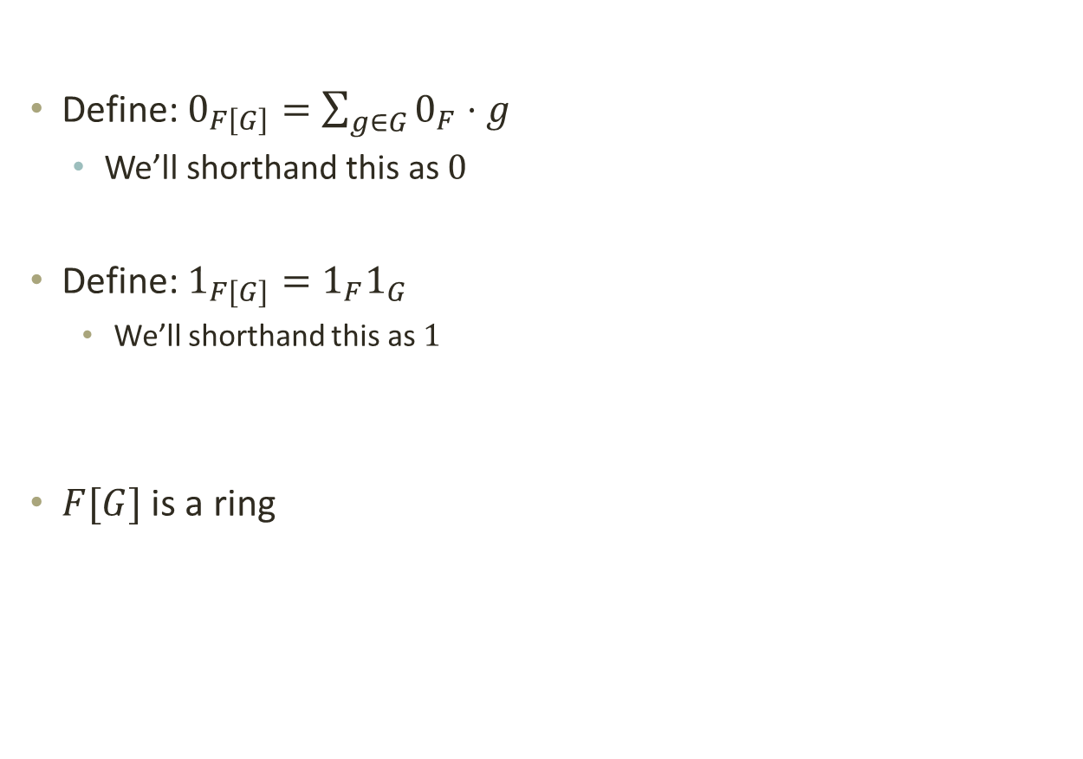
Algebra
Define: $0_{F\left[G\right]}=\sum_{g∈G}{0_{F}⋅g}$
  We’ll shorthand this as $0$
Define: $1_{F[G]}=1_{F}1_{G}$
    We’ll shorthand this as $1$
$F[G]$ is a ring

Slide 12
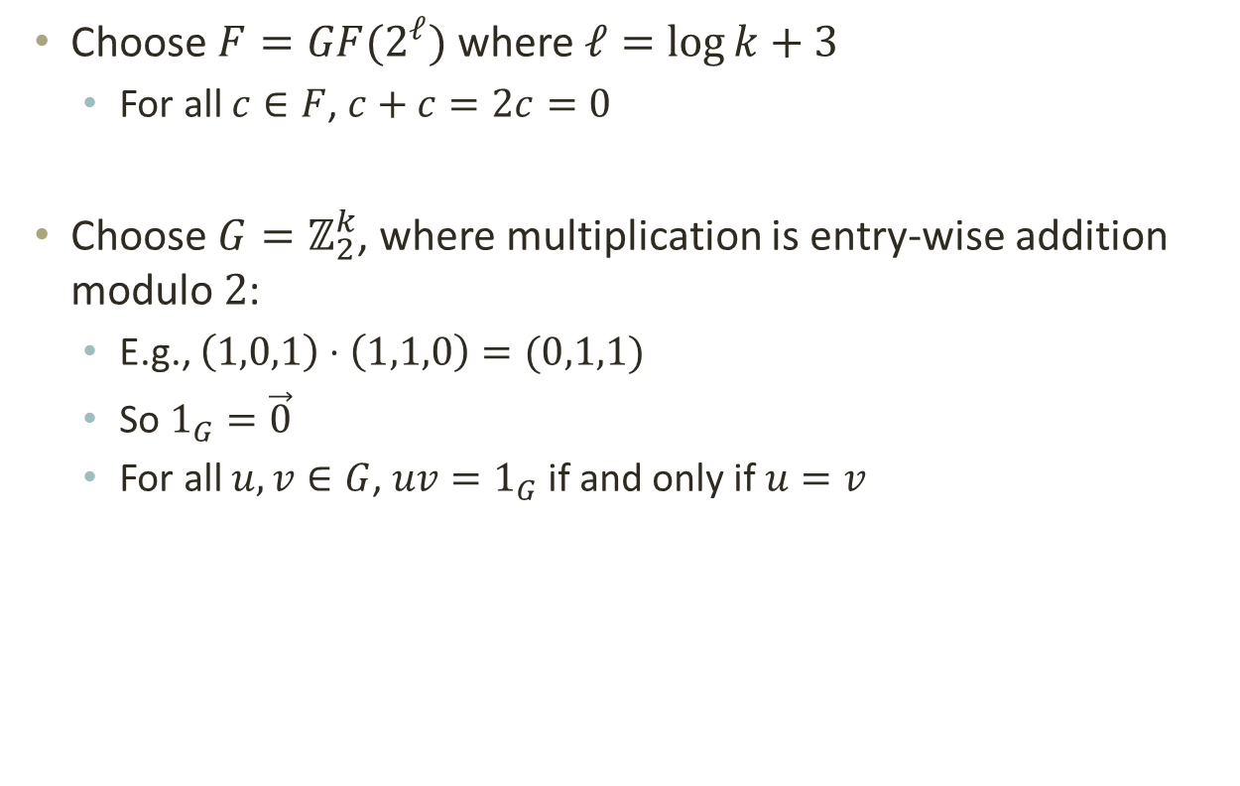
Algebra
Choose $F=GF(2^{ℓ})$ where $ℓ=\log{k}+3$
  For all $c∈F$, $c+c=2c=0$
Choose $G=ℤ_{2}^{k}$, where multiplication is entry-wise addition modulo $2$:
  E.g., $\left(1,0,1\right)⋅\left(1,1,0\right)=(0,1,1)$
  So $1_{G}=\vec{0}$
  For all $u,v∈G$, $uv=1_{G}$ if and only if $u=v$

Slide 13


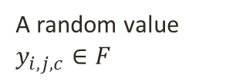
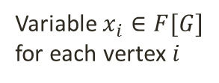
Definition
We define a family of polynomial adjacency matrices for $c=1,…,k−1$:
$$B_{c}\left[i,j\right]=\left\{\begin{aligned}{{y_{i,j,c}⋅x}_{i}⋅z}^{w(i,j)} \text{if} \left(i,j\right)∈E \\ 0 \text{otherwise}\end{aligned}\right.$$
Our operations will be done on $\left(F\left[G\right]\right)[z]$
A random value $y_{i,j,c}∈F$
Variable $x_{i}∈F[G]$ for each vertex $i$
Indeterminate $z$

Slide 14










Main Polynomial
Define $P\left(\vec{x},z\right)= \vec{1}⋅B_{1}⋯B_{k−1}⋅\vec{x}$
$P\left(\vec{x},z\right)$ is a sum on all k-walks in the graph
$$P\left(\vec{x},z\right)=\sum_{\begin{aligned}I=\left\langle i_{1},…,i_{k}\right\rangle \\ \text{is} \text{a} \text{walk}\end{aligned}}{B\left[i_{1},i_{2}\right]⋯B\left[i_{k−1},i_{k}\right]x_{k}}$$
$$B[i_{1},i_{2}]$$
$$B[i_{2},i_{3}]$$
$$B[i_{3},i_{4}]$$
$$B[i_{4},i_{5}]$$
$$i_{1}$$
$$i_{2}$$
$$i_{3}$$
$$i_{4}$$
$$i_{5}$$

Slide 15

Main Polynomial
$P\left(\vec{x},z\right)$ is a sum on all $k$-walks in the graph
$$P\left(\vec{x},z\right)=\sum_{\begin{aligned}I=\left\langle i_{1},…,i_{k}\right\rangle \\ \text{is} \text{a} \text{walk}\end{aligned}}{\prod_{j}{y_{i_{j},i_{j+1},j}}⋅\prod_{j}{x_{i_{j}}}⋅z^{\sum_{j}{w(i_{j},i_{j+1})}}}$$
$$B[i_{1},i_{2}]$$
$$B[i_{2},i_{3}]$$
$$B[i_{3},i_{4}]$$
$$B[i_{4},i_{5}]$$
$$i_{1}$$
$$i_{2}$$
$$i_{3}$$
$$i_{4}$$
$$i_{5}$$

Slide 16
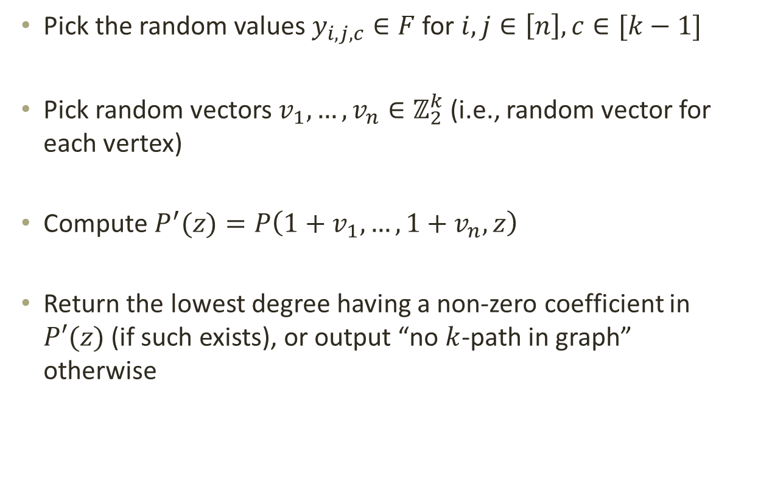
Algorithm
Pick the random values $y_{i,j,c}∈F$ for $i,j∈\left[n\right],c∈[k−1]$
Pick random vectors $v_{1},…,v_{n}∈ℤ_{2}^{k}$ (i.e., random vector for each vertex)
Compute $P^{′}(z)=P\left(1+v_{1},…,1+v_{n},z\right)$
Return the lowest degree having a non-zero coefficient in $P′(z)$ (if such exists), or output “no $k$-path in graph” otherwise

Slide 17
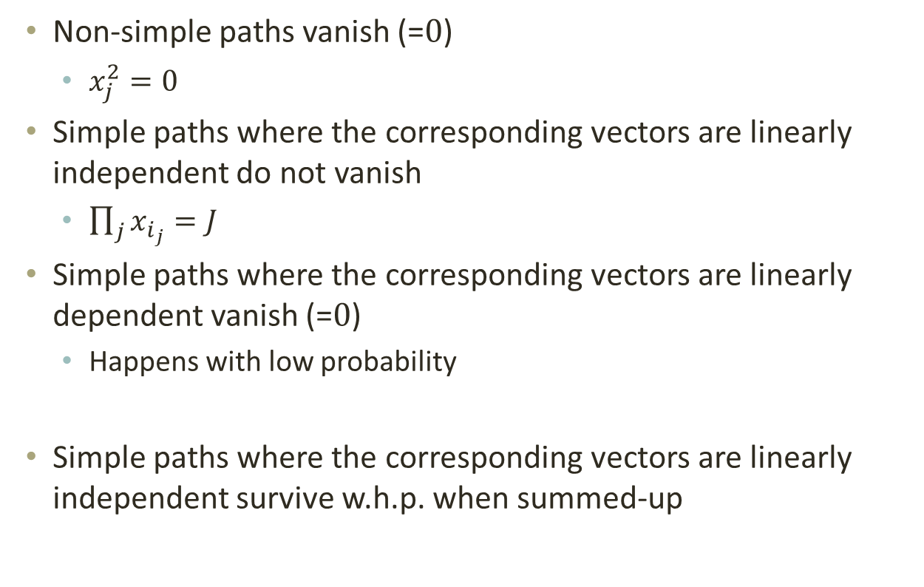
Propositions
Non-simple paths vanish (=$0$)
  $x_{j}^{2}=0$
Simple paths where the corresponding vectors are linearly independent do not vanish
  $\prod_{j}{x_{i_{j}}}=J$
Simple paths where the corresponding vectors are linearly dependent vanish (=$0$)
  Happens with low probability
Simple paths where the corresponding vectors are linearly independent survive w.h.p. when summed-up

Slide 18
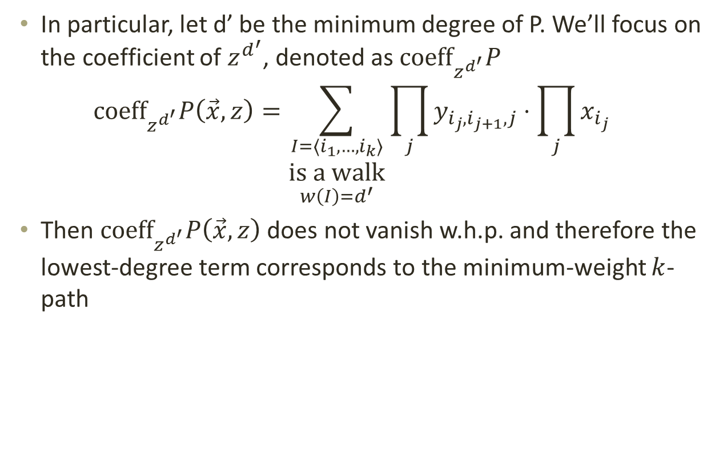

Minimum-Degree of $P$
In particular, let d’ be the minimum degree of P. We’ll focus on the coefficient of $z^{d^{′}}$, denoted as ${\text{coeff}}_{z^{d^{′}}}P$
$${\text{coeff}}_{z^{d^{′}}}P\left(\vec{x},z\right)=\sum_{\begin{aligned}I=\left\langle i_{1},…,i_{k}\right\rangle \\ \text{is} \text{a} \text{walk} \\ w\left(I\right)=d^{′}\end{aligned}}{\prod_{j}{y_{i_{j},i_{j+1},j}}⋅\prod_{j}{x_{i_{j}}}}$$
Then ${\text{coeff}}_{z^{d^{′}}}P\left(\vec{x},z\right)$ does not vanish w.h.p. and therefore the lowest-degree term corresponds to the minimum-weight $k$-path

Slide 19

Running Time
Dominated by multiplying two polynomials in $(F\left[G\right])[z]$ of degree at most $kM$.
  Can be done in $\tilde{O}\left(2^{k}k^{2}M\right)$ by using multi-dimensional FFT
Running time is $\tilde{O}\left(2^{k}poly\left(k\right)Mn^{ω}\right)=O^{∗}(2^{k}M)$

Slide 20
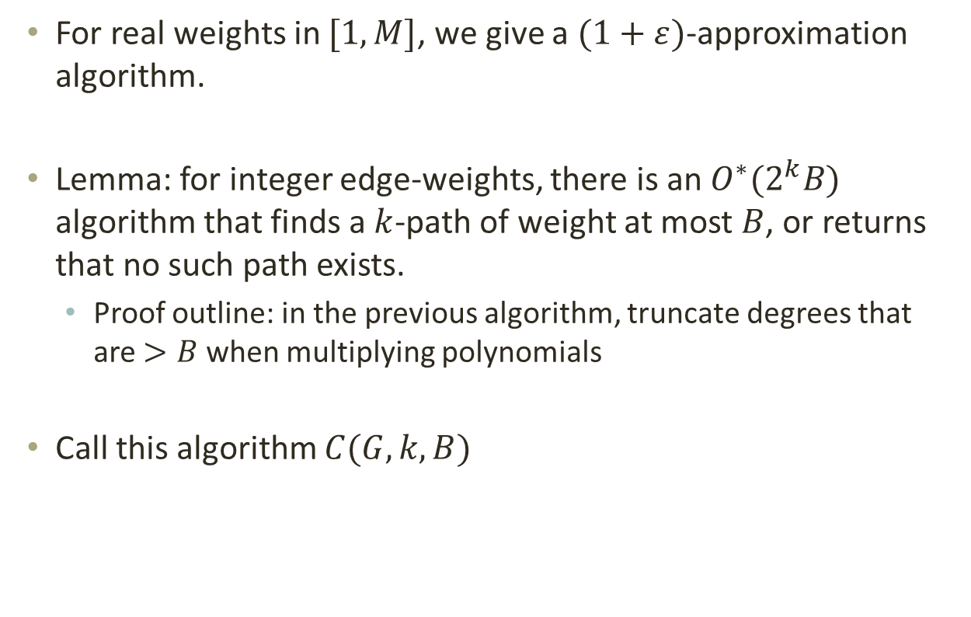
Approximation
For real weights in $[1,M]$, we give a $(1+ε)$-approximation algorithm.
Lemma: for integer edge-weights, there is an $O^{∗}(2^{k}B)$ algorithm that finds a $k$-path of weight at most $B$, or returns that no such path exists.
  Proof outline: in the previous algorithm, truncate degrees that are $>B$ when multiplying polynomials
Call this algorithm $C(G,k,B)$

Slide 21
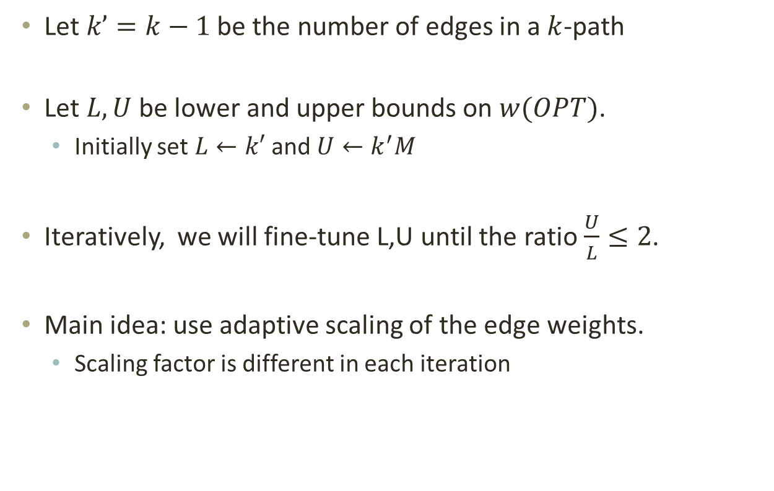
Idea
Let $k’=k−1$ be the number of edges in a $k$-path
Let $L,U$ be lower and upper bounds on $w(OPT)$.
  Initially set $L←k′$ and $U←k^{′}M$
Iteratively, we will fine-tune L,U until the ratio $\frac{U}{L}≤2$.
Main idea: use adaptive scaling of the edge weights.
  Scaling factor is different in each iteration

Slide 22
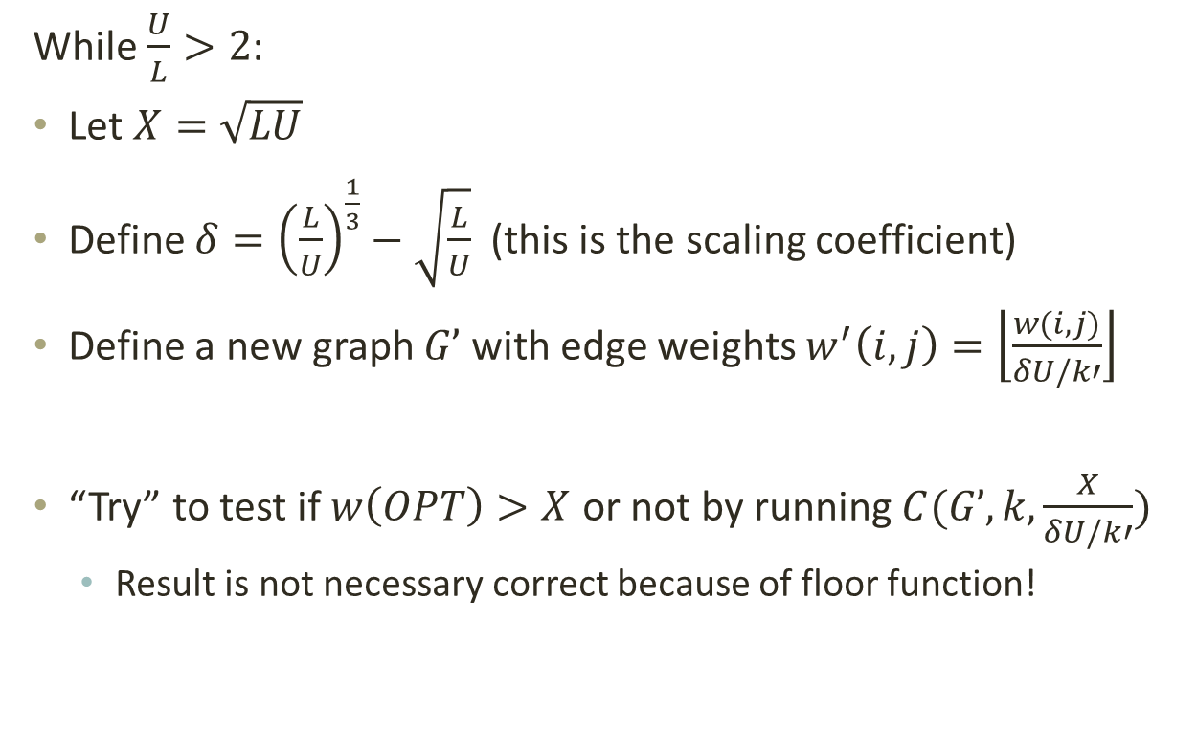
Fine-Tuning
While $\frac{U}{L}>2$:
Let $X=\sqrt{LU}$
Define $δ={\left(\frac{L}{U}\right)}^{\frac{1}{3}}−\sqrt{\frac{L}{U}}$ (this is the scaling coefficient)
Define a new graph $G’$ with edge weights $w^{′}\left(i,j\right)=\left\lfloor \frac{w(i,j)}{δU/k′}\right\rfloor$
“Try” to test if $w\left(OPT\right)>X$ or not by running $C(G’,k,\frac{X}{δU/k′})$
  Result is not necessary correct because of floor function!

Slide 23



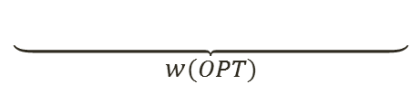


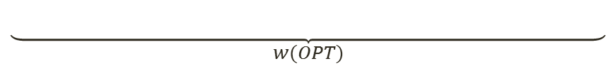




Loss of Precision
Loss of precision is $δU/k′$, per edge, or equiv. $δU$ per k-path
If $C(G’,k,\frac{X}{δU/k′})$=“no” then $w\left(OPT\right)>X$
But if $C(G’,k,\frac{X}{δU/k′})$=“yes” then $w\left(OPT\right)≤X+δU$
$$L$$
$$X$$
$$X+δU$$
$$U$$
$$\underset{w(OPT)}{\underbrace{ }}$$
$$L$$
$$X$$
$$X+δU$$
$$U$$
$$\underset{w(OPT)}{\underbrace{ }}$$

Slide 24


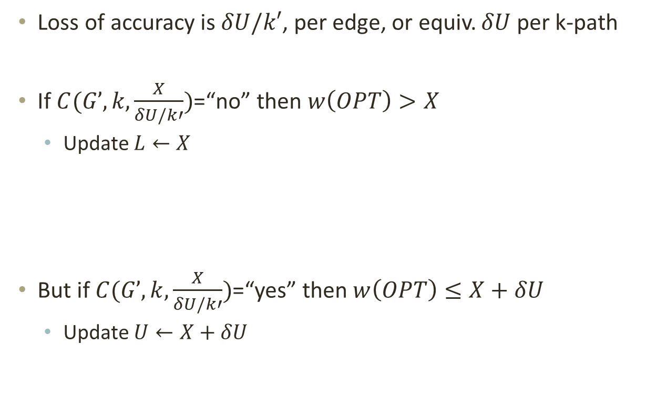


Fine-Tuning
Loss of accuracy is $δU/k′$, per edge, or equiv. $δU$ per k-path
If $C(G’,k,\frac{X}{δU/k′})$=“no” then $w\left(OPT\right)>X$
  Update $L←X$
But if $C(G’,k,\frac{X}{δU/k′})$=“yes” then $w\left(OPT\right)≤X+δU$
  Update $U←X+δU$
$$L$$
$$X$$
$$X+δU$$
$$U$$
$$L$$
$$L$$
$$X$$
$$X+δU$$
$$U$$
$$U$$

Slide 25
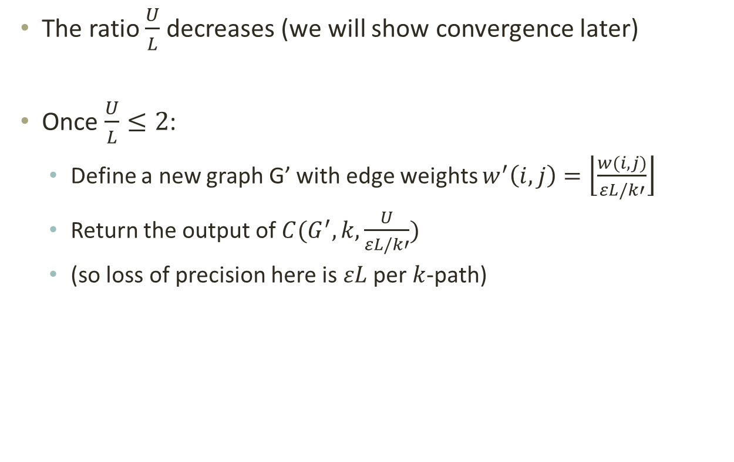
Algorithm
The ratio $\frac{U}{L}$ decreases (we will show convergence later)
Once $\frac{U}{L}≤2$:
  Define a new graph G’ with edge weights $w^{′}\left(i,j\right)=\left\lfloor \frac{w(i,j)}{εL/k′}\right\rfloor$
  Return the output of $C(G^{′},k,\frac{U}{εL/k′})$
  (so loss of precision here is $εL$ per $k$-path)

Slide 26
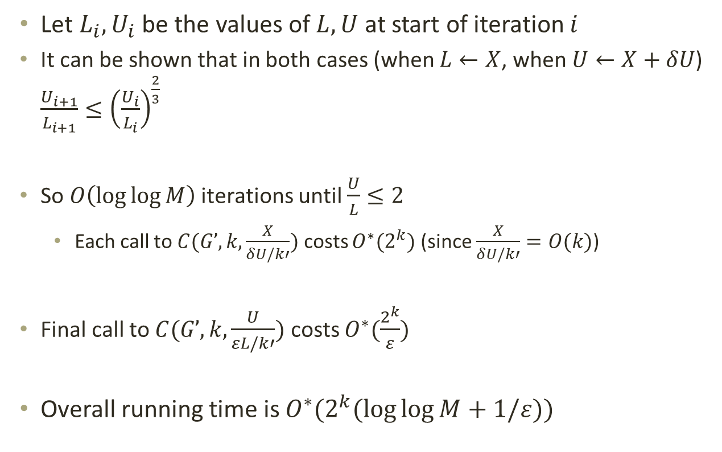
Running Time
Let $L_{i},U_{i}$ be the values of $L,U$ at start of iteration $i$
  It can be shown that in both cases (when $L←X$, when $U←X+δU$) $\frac{U_{i+1}}{L_{i+1}}≤{\left(\frac{U_{i}}{L_{i}}\right)}^{\frac{2}{3}}$
  So $O\left(log\log{M}\right)$ iterations until $\frac{U}{L}≤2$
    Each call to $C(G’,k,\frac{X}{δU/k′})$ costs $O^{∗}(2^{k})$ (since $\frac{X}{δU/k′}=O(k)$)
  Final call to $C(G’,k,\frac{U}{εL/k′})$ costs $O^{∗}(\frac{2^{k}}{ε})$
Overall running time is $O^{∗}(2^{k}(\log{\log{M}}+1/ε))$

Slide 27
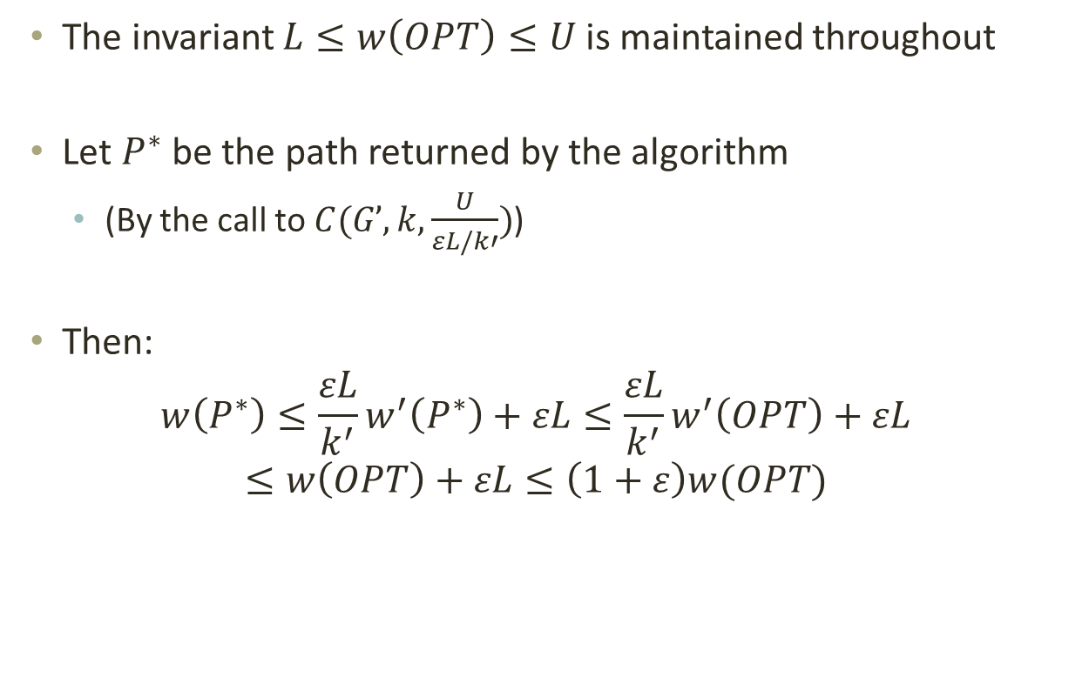
Correctness
The invariant $L≤w\left(OPT\right)≤U$ is maintained throughout
Let $P^{∗}$ be the path returned by the algorithm
  (By the call to $C(G’,k,\frac{U}{εL/k′})$)
Then:
$$w\left(P^{∗}\right)≤\frac{εL}{k^{′}}w^{′}\left(P^{∗}\right)+εL≤\frac{εL}{k^{′}}w^{′}\left(OPT\right)+εL$$
$$≤w\left(OPT\right)+εL≤\left(1+ε\right)w(OPT)$$

Slide 28
Thanks!

